Slide 1
Mod 05 - Recursion

Slide 2
Mod 05 - Recursion
START RECORDING

Slide 3
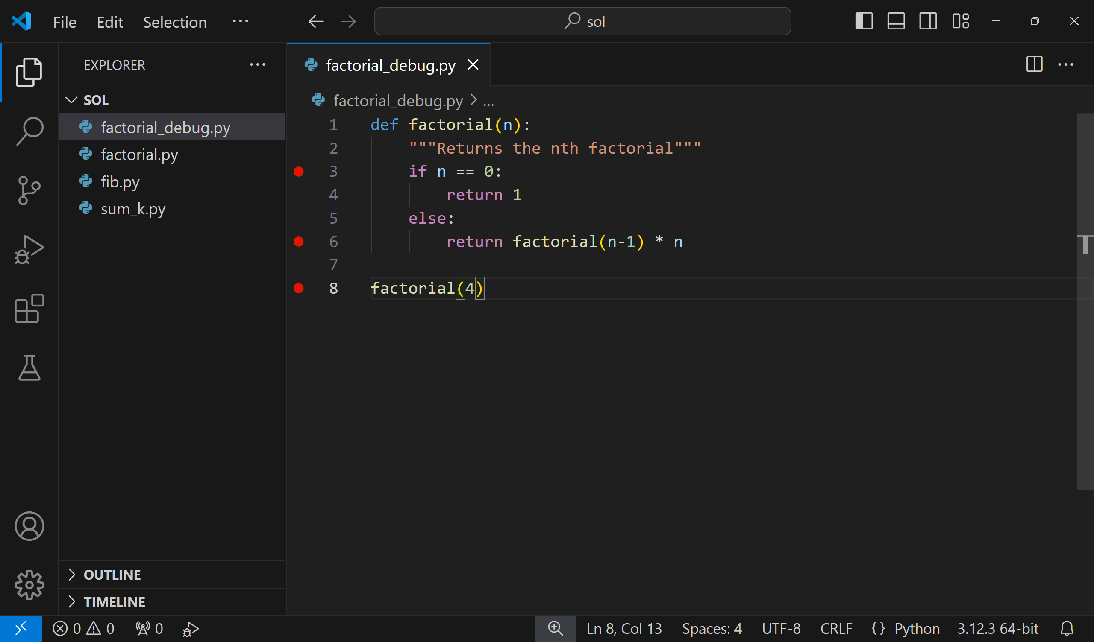

The Debugger
A debugger helps us debug by allowing us to freeze our code in certain spots and inspect variables at that point.
Always helpful, the debugger becomes critical when writing recursive functions, since we can see values of variables at different levels of recursion.
Debugging flow:
Create one or more breakpoints
Run our code in debugging mode
Analyze our variables at that breakpoint
Step through our code until we find the bug

Slide 4
Create breakpoints by clicking to the left of line numbers.

Slide 5
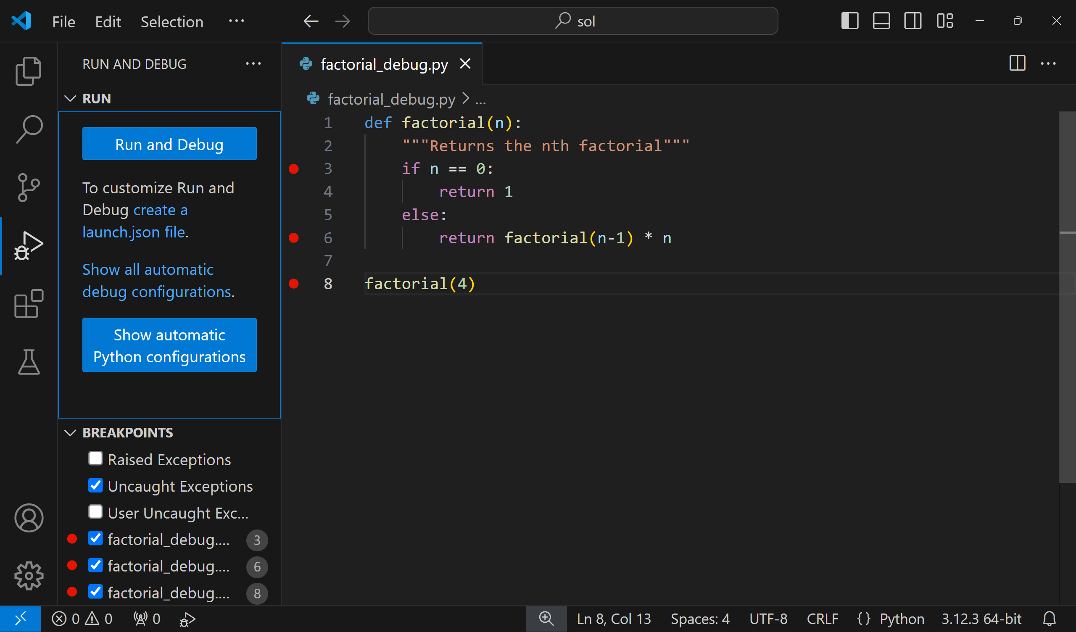
Debug by clicking the debug icon, then "Run and Debug"
You may have to select a python interpreter the first time you do this.

Slide 6
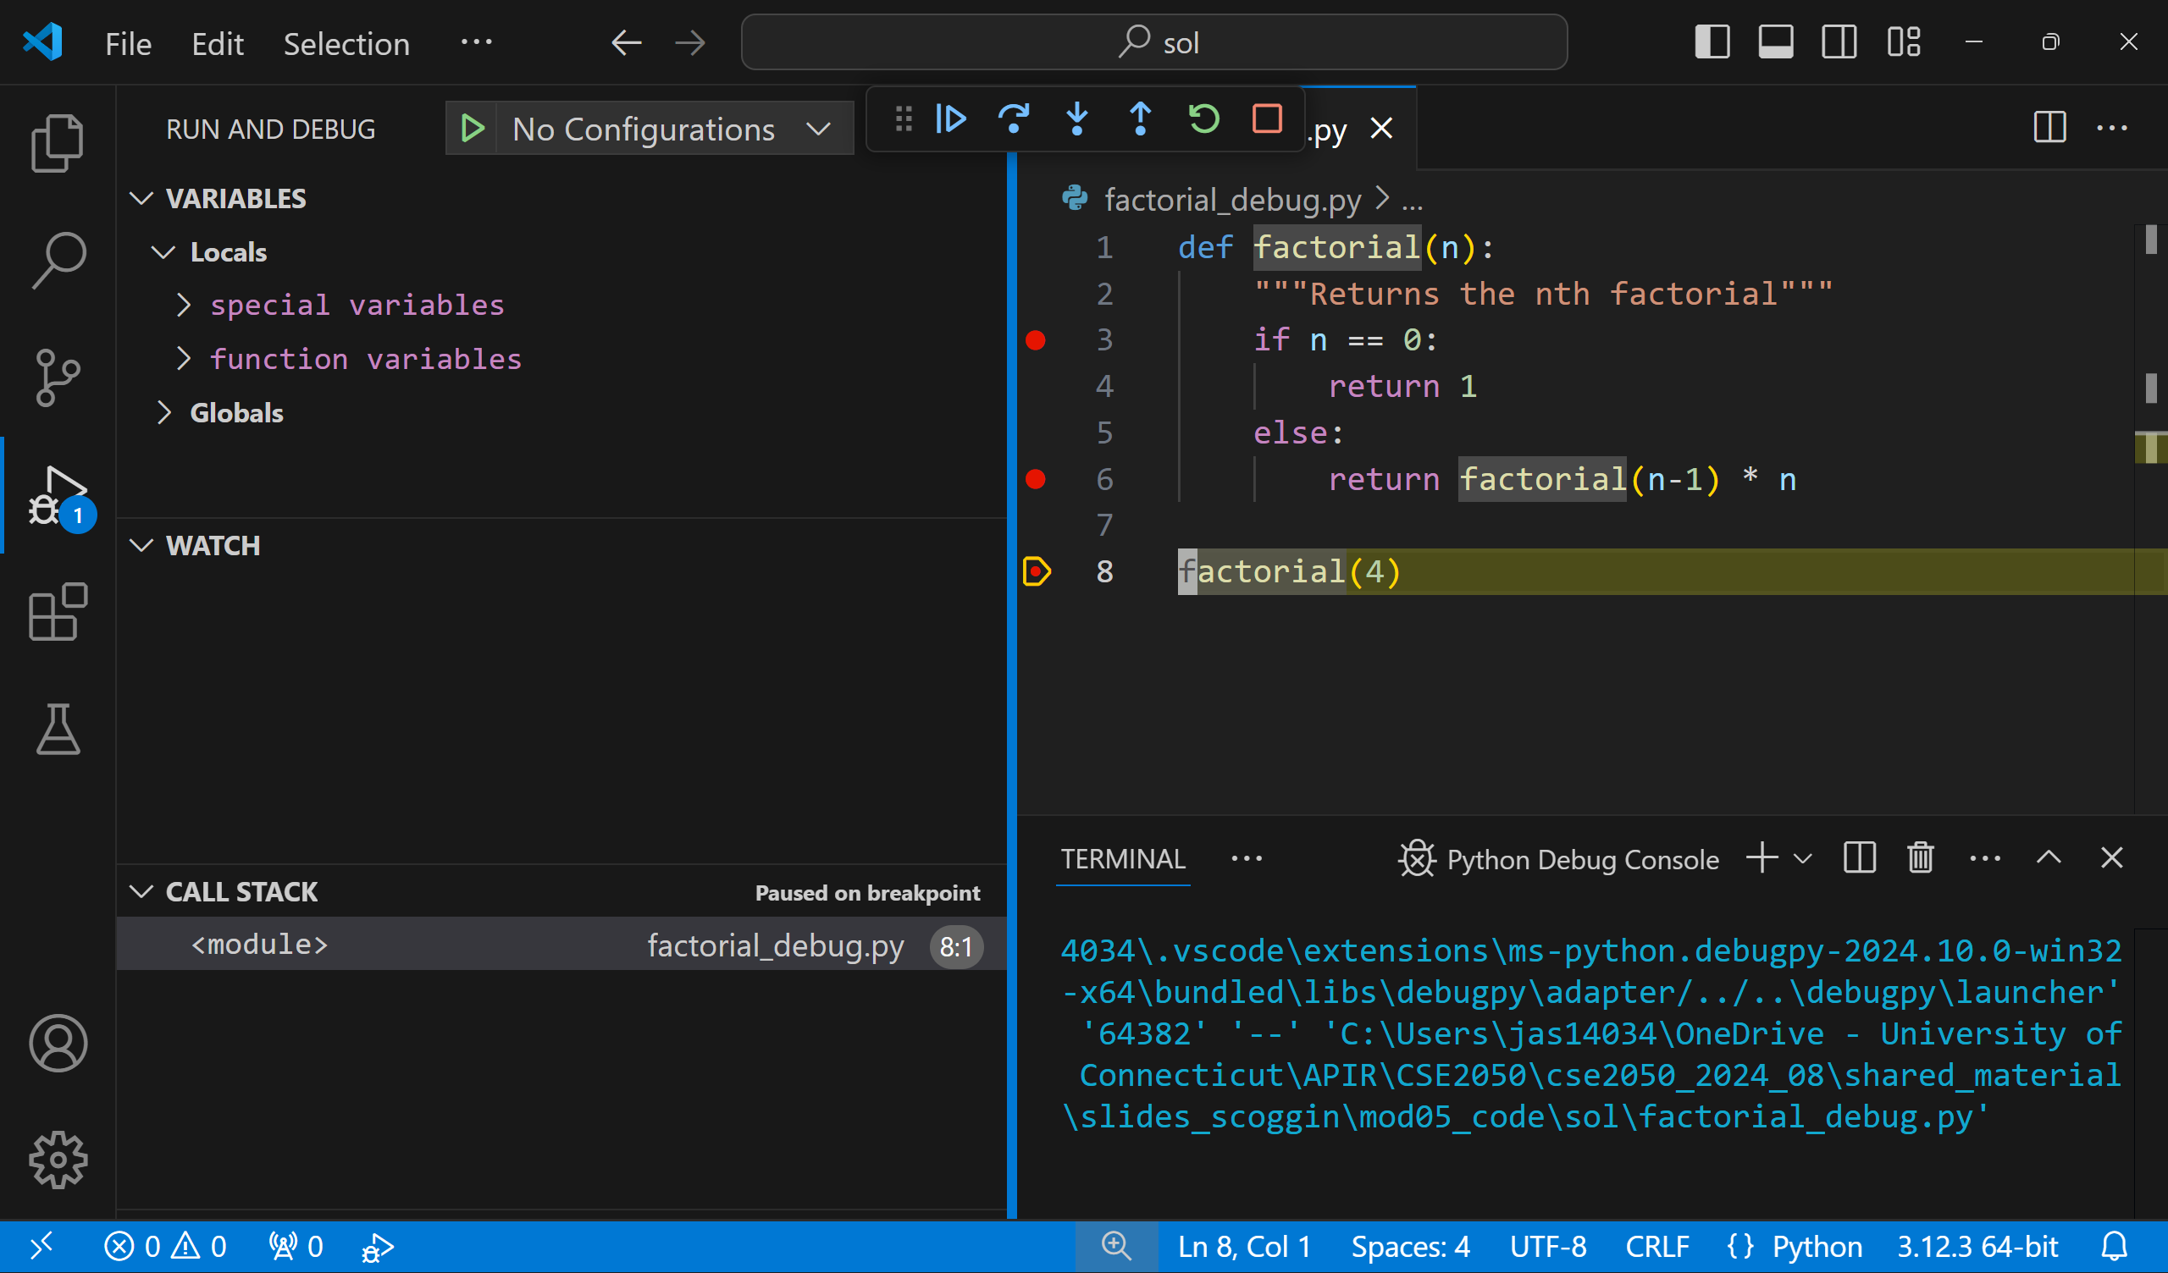
Step through our code with these.
Local namespace (variables, functions, classes,...) here
We can add variables to "watch" to make them easier to keep track of visually
Our code freezes at the first breakpoint (here, line 8).
The function call stack

Slide 7

Continue (until next breakpoint)
Step Into (Move ahead one operation. If this line calls a function, we will freeze at the top of that function)
Stop (debugger)
Step Over (Move ahead one line in the current function)

Slide 8
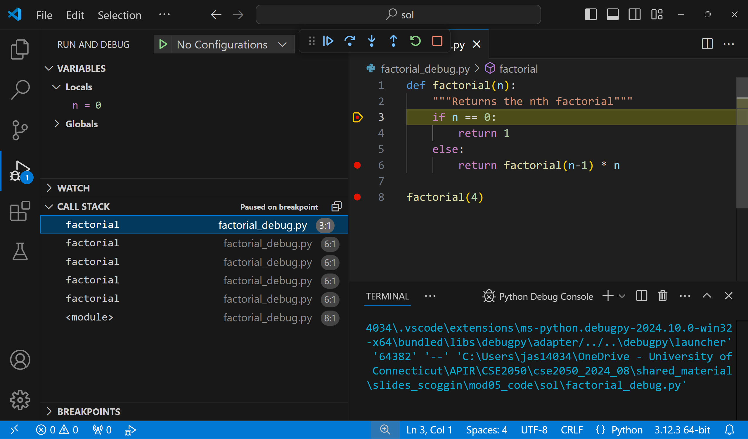
?
The local value of `n` is 0
Step into goes to line 4
Our code is frozen on line 3
5 function calls on stack

Slide 9
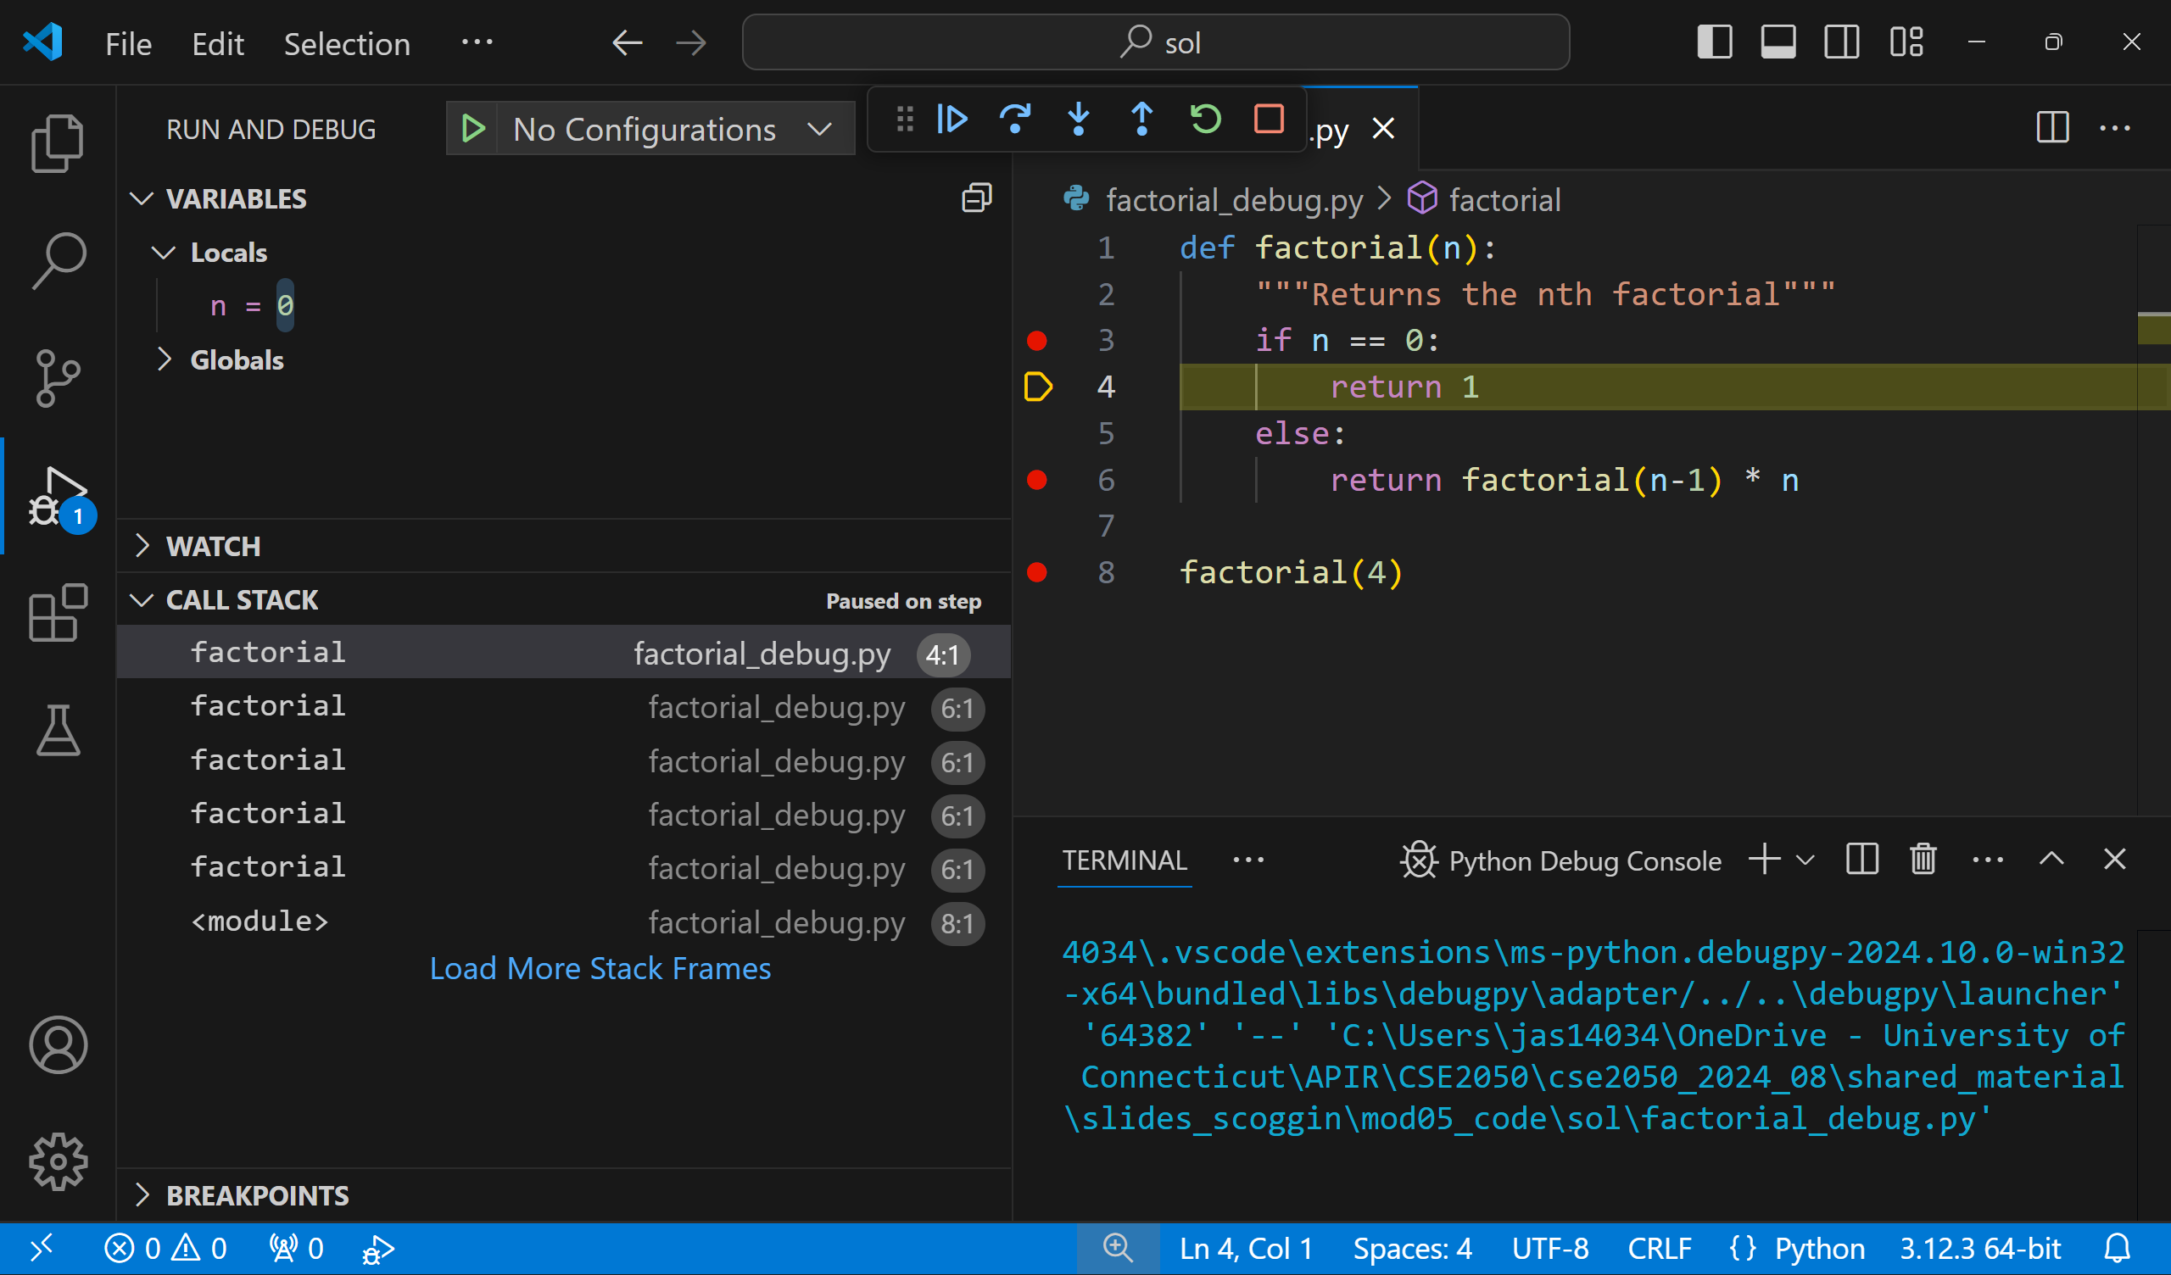
Step into returns 1 to the next call on the stack and pauses

Slide 10
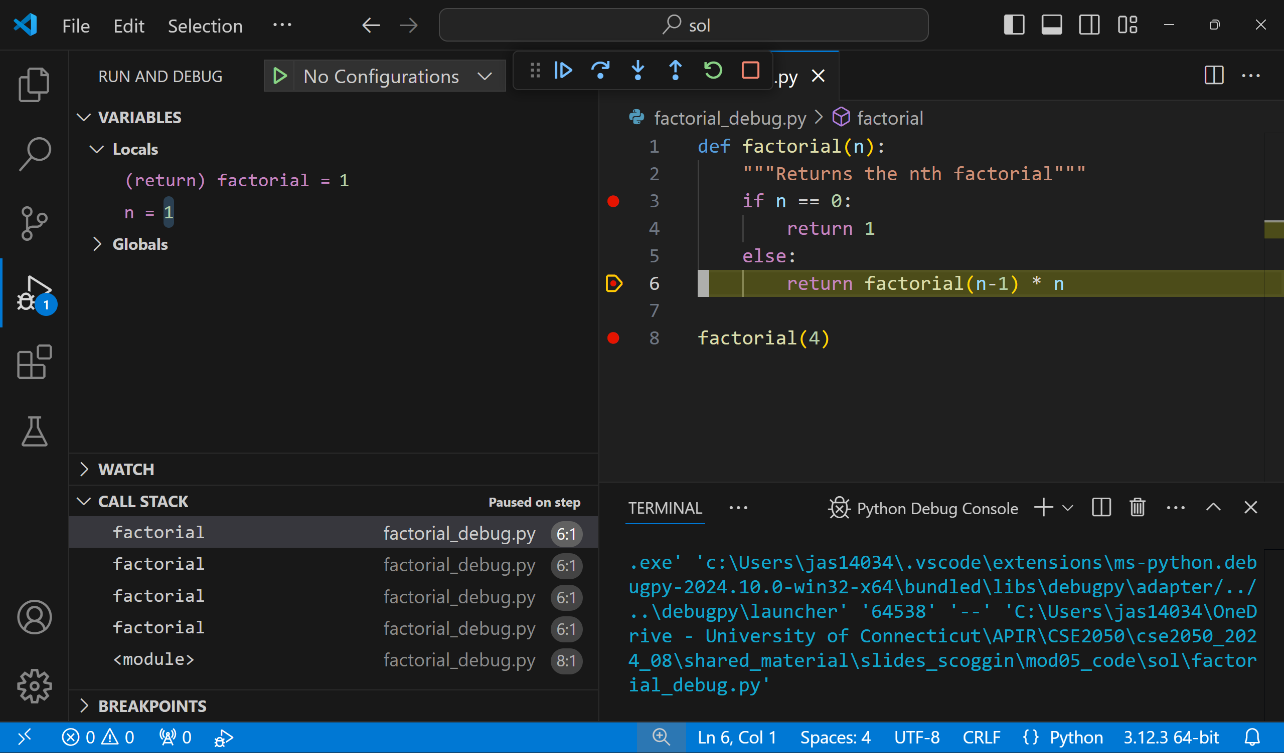
factorial(0) returned 1
We are paused during the execution of line 6

Slide 11
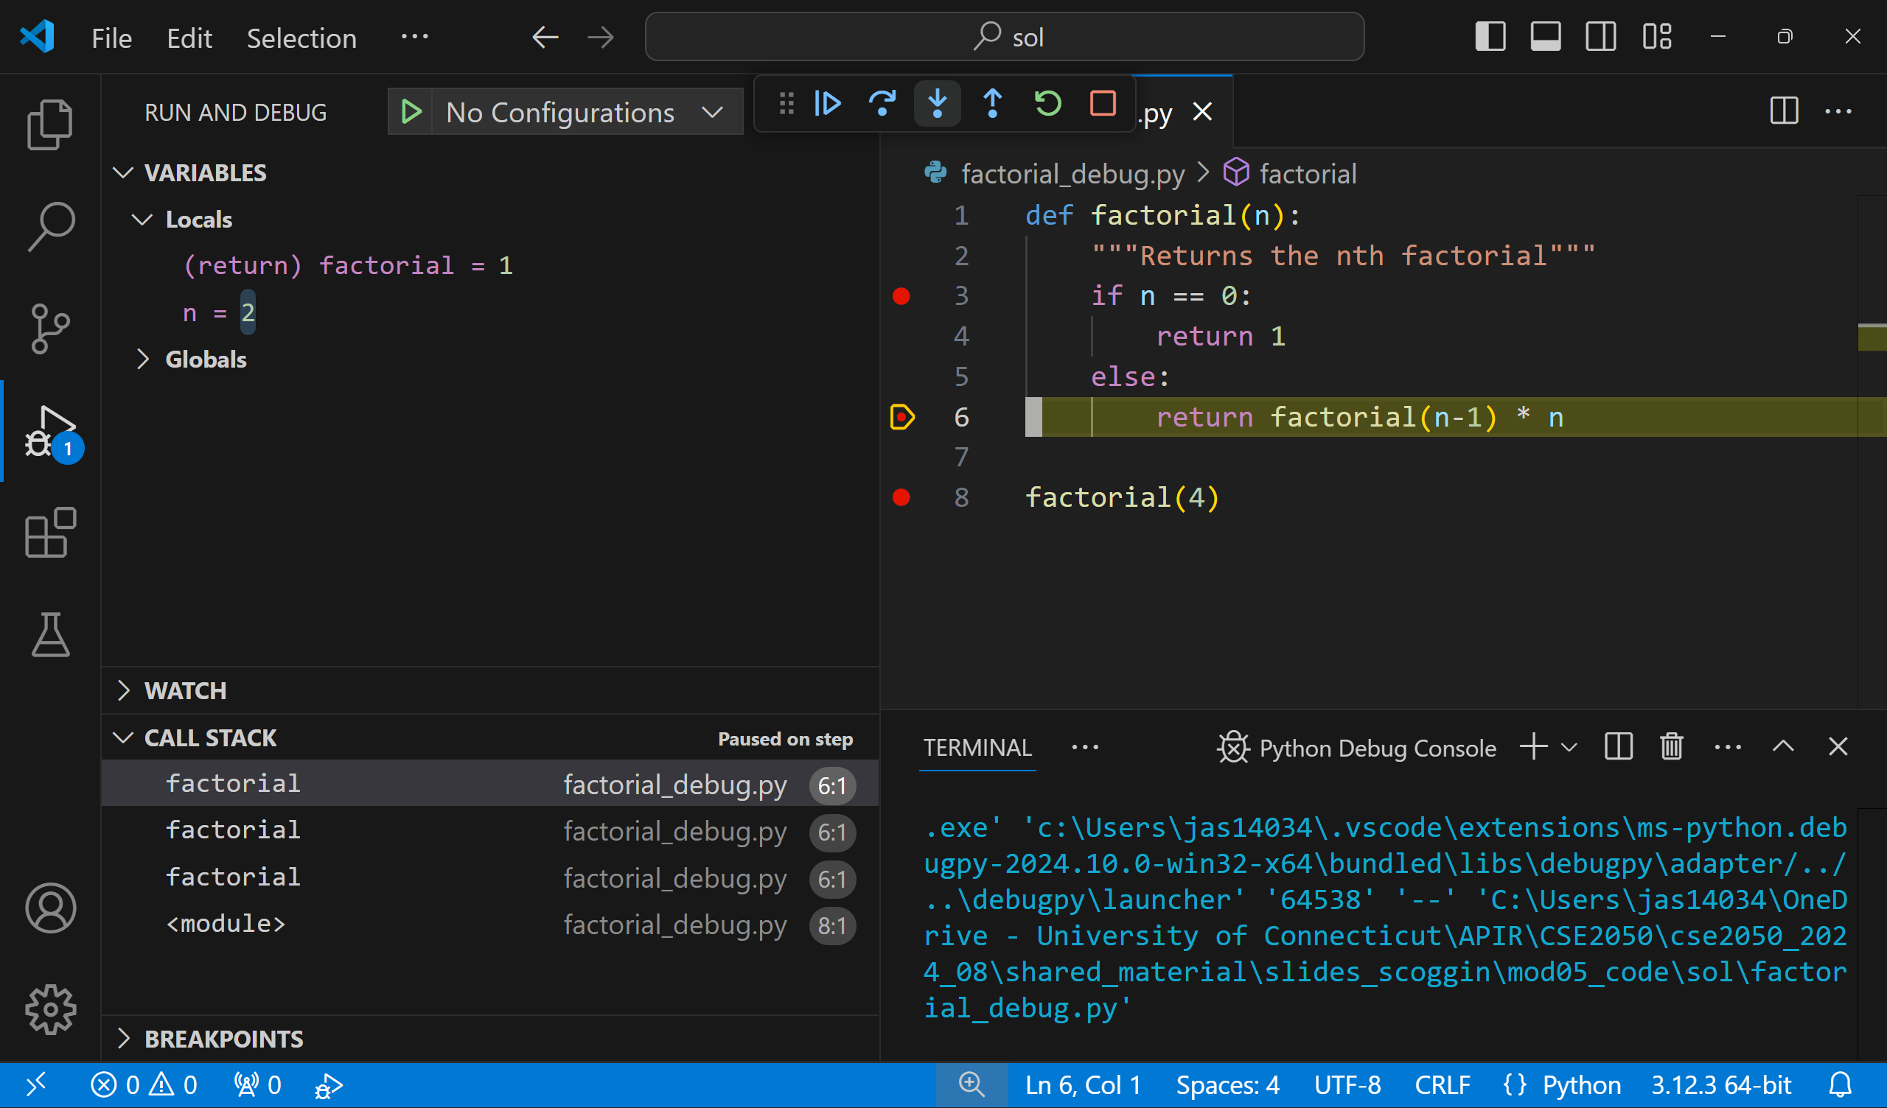
factorial(1) returned 1

Slide 12
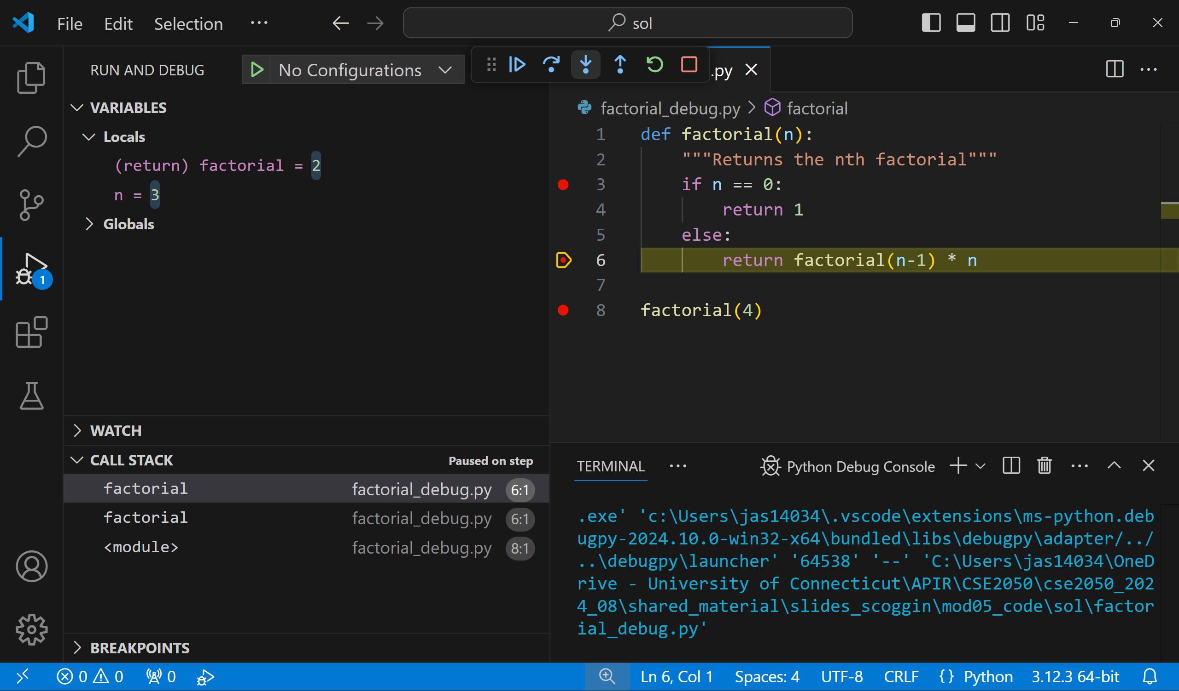
factorial(2) returned 2

Slide 13
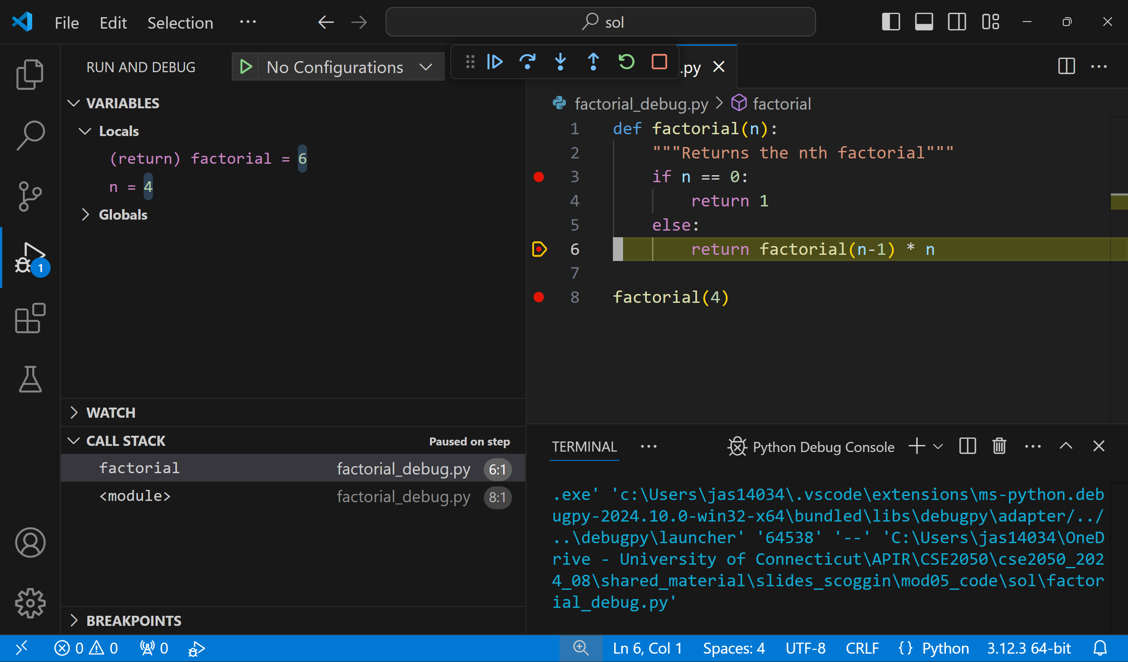
factorial(3) returned 6

Slide 14
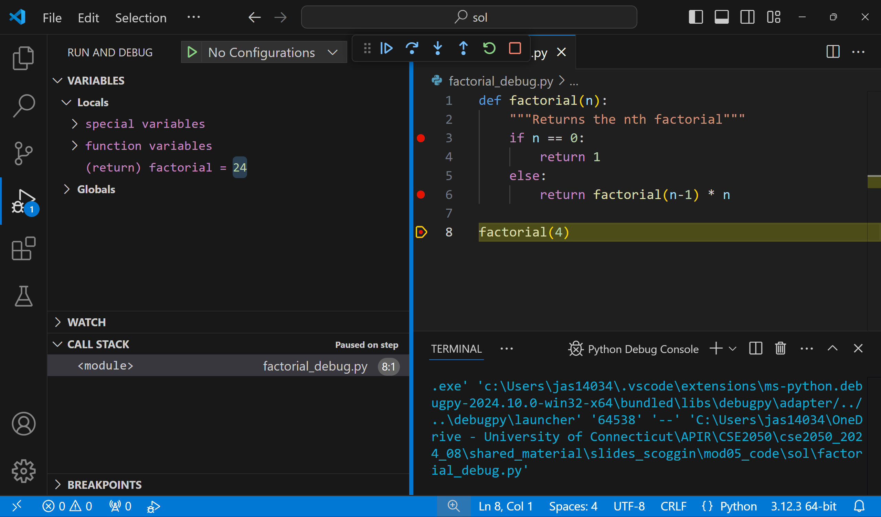
factorial(4) returned 24

Slide 15
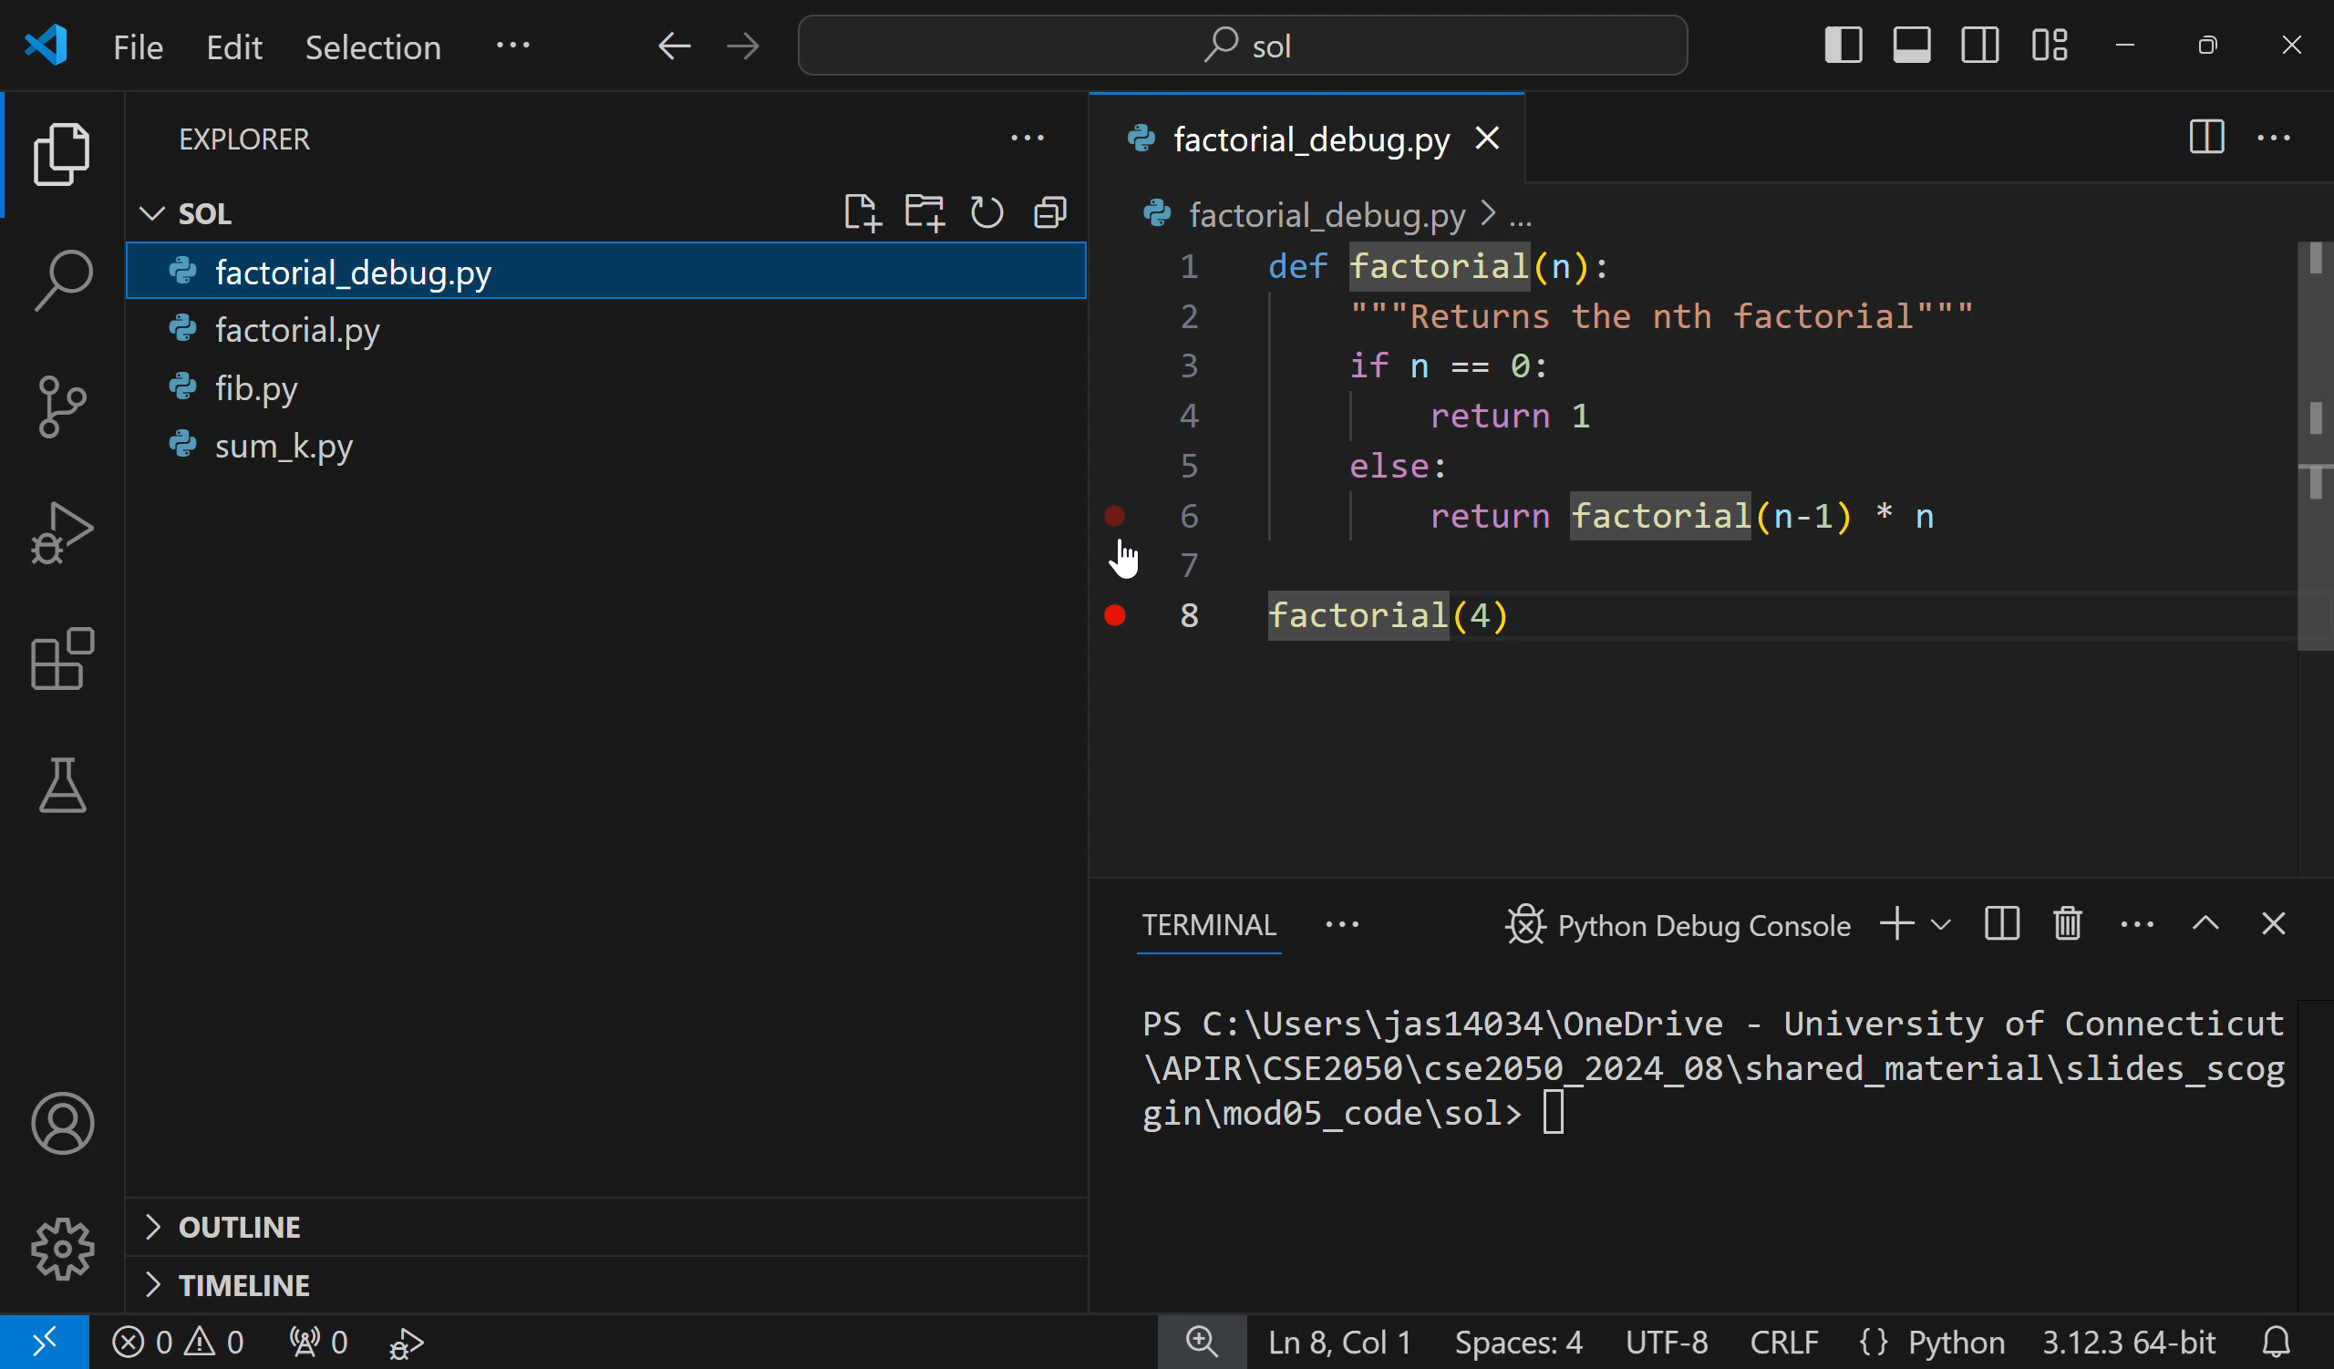

Slide 16
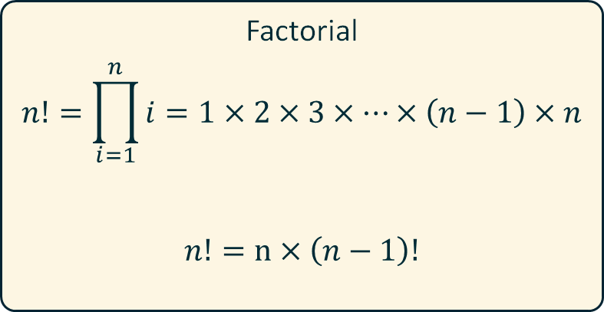
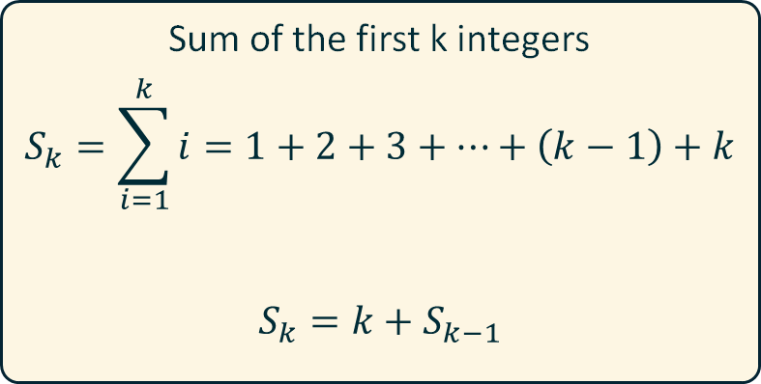

Numeric Series
Many numeric series have an elegant recursive expression
Sometimes, there may not be an obvious iterative expression
In all cases, the recursive expressions need a base case
Sum of the first k integers
$$S_{k}=\sum_{i=1}^{k}{i=1+2+3+…+\left(k−1\right)+k}$$
$$S_{k}=k+S_{k−1}$$
Factorial
$$n!=\prod_{i=1}^{n}{i}=1×2×3×…×\left(n−1\right)×n$$
$$n!=n×\left(n−1\right)!$$
Fibonacci
$$F_{k}=F_{k−1}+F_{k−2}$$

Slide 17
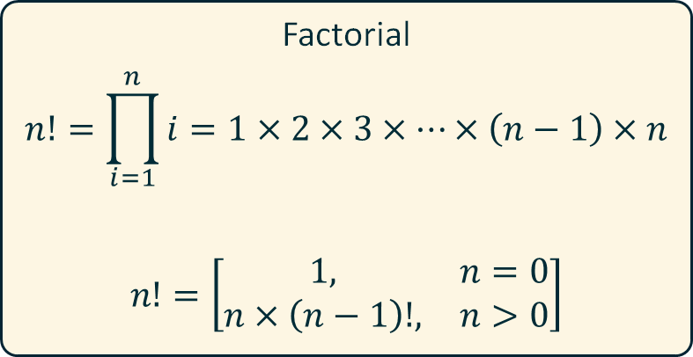
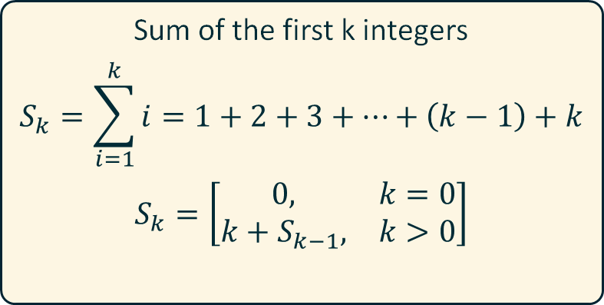
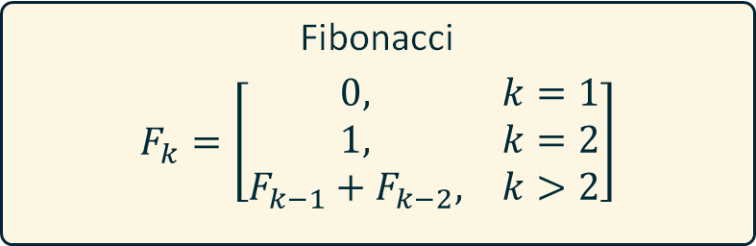
Numeric Series
Many numeric series have an elegant recursive expression
Sometimes, there may not be an obvious iterative expression
In all cases, the recursive expressions need a base case
Sum of the first k integers
$$S_{k}=\sum_{i=1}^{k}{i=1+2+3+…+\left(k−1\right)+k}$$
$$S_{k}=\left[\begin{matrix}0, & k=0 \\ k+S_{k−1}, & k>0\end{matrix}\right]$$
Factorial
$$n!=\prod_{i=1}^{n}{i}=1×2×3×…×\left(n−1\right)×n$$
$$n!=\left[\begin{matrix}1, & n=0 \\ n×\left(n−1\right)!, & n>0\end{matrix}\right]$$
Fibonacci
$$F_{k}=\left[\begin{matrix}0, & k=1 \\ 1, & k=2 \\ F_{k−1}+F_{k−2}, & k>2\end{matrix}\right]$$

Slide 18
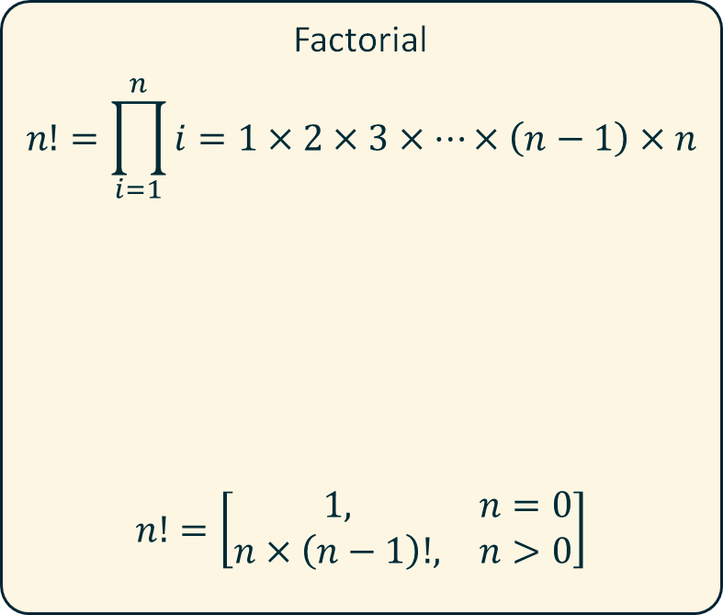
Factorial
$$n!=\prod_{i=1}^{n}{i}=1×2×3×…×\left(n−1\right)×n$$
$$n!=\left[\begin{matrix}1, & n=0 \\ n×\left(n−1\right)!, & n>0\end{matrix}\right]$$
def factorial_iter(n):
"""Returns the nth factorial"""
product = 1
for number in range(1, n+1):
product *= number
return product
def factorial_recr(n):
if n == 0: return 1
else: return factorial_recr(n-1) * n

Slide 19
Ternary (three-term) if statement
if condition:
return ValueIfTrue
else:
return ValueIfFalse
return ValueIfTrue if condition else ValueIfFalse
def factorial_recr(n):
if n == 0: return 1
else: return n * factorial_recr(n-1)
Write the above in 1-line using a ternary if

Slide 20
Ternary (three-term) if statement
if condition:
return ValueIfTrue
else:
return ValueIfFalse
return ValueIfTrue if condition else ValueIfFalse
def factorial_recr(n):
if n == 0: return 1
else: return n * factorial_recr(n-1)
def factorial_recr(n):
return 1 if n==0 else n * factorial_recr(n-1)

Slide 21
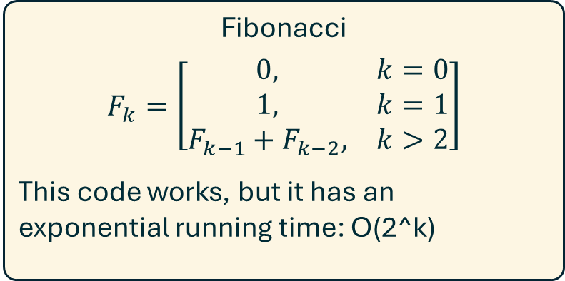
Fibonacci
$$F_{k}=\left[\begin{matrix}0, & k=0 \\ 1, & k=1 \\ F_{k−1}+F_{k−2}, & k>2\end{matrix}\right]$$
This code works, but it has an exponential running time: O(2^k)
def fib(k):
"""Returns the kth fibonacci number"""
if k == 0: return 0
elif k == 1: return 1
return fib(k-1) + fib(k-2)
F₅
F₄
F₃
F₃
F₂
F₂
F₁
F₂
F₁
F₁
F₀
F₁
F₀
F₁
F₀

Slide 22
On the stack
Fib(4)
k=4
fib(k-1)=...
def fib(k):
if k == 0: return 0
elif k == 1: return 1
return fib(k-1) + fib(k-2)
Resolved
Fib(3)
k=3
fib(k-1)=...
Fib(2)
k=2
fib(k-1)=...
1
Fib(1)
k=1
return 1

Slide 23
On the stack
Fib(4)
k=4
fib(k-1)=...
def fib(k):
if k == 0: return 0
elif k == 1: return 1
return fib(k-1) + fib(k-2)
Resolved
Fib(3)
k=3
fib(k-1)=...
Fib(2)
k=2
fib(k-1)= 1
fib(k-2)=...
1
0
Fib(1)
k=1
return 1
Fib(0)
k=0
return 0

Slide 24
On the stack
Fib(4)
k=4
fib(k-1)=...
def fib(k):
if k == 0: return 0
elif k == 1: return 1
return fib(k-1) + fib(k-2)
Resolved
Fib(3)
k=3
fib(k-1)=...
1
Fib(2)
k=2
fib(k-1)= 1
fib(k-2)= 0
1
0
Fib(1)
k=1
return 1
Fib(0)
k=0
return 0

Slide 25
On the stack
Fib(4)
k=4
fib(k-1)=...
def fib(k):
if k == 0: return 0
elif k == 1: return 1
return fib(k-1) + fib(k-2)
Resolved
Fib(3)
k=3
fib(k-1)= 1
fib(k-2)=...
1
1
Fib(2)
k=2
fib(k-1)= 1
fib(k-2)= 0
Fib(1)
k=1
return 1
1
0
Fib(1)
k=1
return 1
Fib(0)
k=0
return 0

Slide 26
On the stack
Fib(4)
k=4
fib(k-1)=...
def fib(k):
if k == 0: return 0
elif k == 1: return 1
return fib(k-1) + fib(k-2)
Resolved
2
Fib(3)
k=3
fib(k-1)= 1
fib(k-2)= 1
1
1
Fib(2)
k=2
fib(k-1)= 1
fib(k-2)= 0
Fib(1)
k=1
return 1
1
0
Fib(1)
k=1
return 1
Fib(0)
k=0
return 0

Slide 27
On the stack
Fib(4)
k=4
fib(k-1)=2
fib(k-2)=...
def fib(k):
if k == 0: return 0
elif k == 1: return 1
return fib(k-1) + fib(k-2)
Resolved
2
Fib(3)
k=3
fib(k-1)= 1
fib(k-2)= 1
Fib(2)
k=2
fib(k-1)=...
1
1
1
Fib(2)
k=2
fib(k-1)= 1
fib(k-2)= 0
Fib(1)
k=1
return 1
Fib(1)
k=1
return 1
1
0
Fib(1)
k=1
return 1
Fib(0)
k=0
return 0

Slide 28
On the stack
Fib(4)
k=4
fib(k-1)=2
fib(k-2)=...
def fib(k):
if k == 0: return 0
elif k == 1: return 1
return fib(k-1) + fib(k-2)
Resolved
2
Fib(3)
k=3
fib(k-1)= 1
fib(k-2)= 1
Fib(2)
k=2
fib(k-1)=1
fib(k-2)=...
1
1
1
0
Fib(2)
k=2
fib(k-1)= 1
fib(k-2)= 0
Fib(1)
k=1
return 1
Fib(1)
k=1
return 1
Fib(0)
k=0
return 0
1
0
Fib(1)
k=1
return 1
Fib(0)
k=0
return 0

Slide 29
On the stack
Fib(4)
k=4
fib(k-1)=2
fib(k-2)=...
def fib(k):
if k == 0: return 0
elif k == 1: return 1
return fib(k-1) + fib(k-2)
Resolved
2
1
Fib(3)
k=3
fib(k-1)= 1
fib(k-2)= 1
Fib(2)
k=2
fib(k-1)=1
fib(k-2)=0
1
1
1
0
Fib(2)
k=2
fib(k-1)= 1
fib(k-2)= 0
Fib(1)
k=1
return 1
Fib(1)
k=1
return 1
Fib(0)
k=0
return 0
1
0
Fib(1)
k=1
return 1
Fib(0)
k=0
return 0

Slide 30
Whatever called Fib(4)
3
Fib(4)
k=4
fib(k-1)=2
fib(k-2)=1
def fib(k):
if k == 0: return 0
elif k == 1: return 1
return fib(k-1) + fib(k-2)
On the stack
2
1
Fib(3)
k=3
fib(k-1)= 1
fib(k-2)= 1
Fib(2)
k=2
fib(k-1)=1
fib(k-2)=0
Resolved
1
1
1
0
Fib(2)
k=2
fib(k-1)= 1
fib(k-2)= 0
Fib(1)
k=1
return 1
Fib(1)
k=1
return 1
Fib(0)
k=0
return 0
1
0
Fib(1)
k=1
return 1
Fib(0)
k=0
return 0

Slide 31
Whatever called Fib(4)
3
Fib(4)
k=4
fib(k-1)=2
fib(k-2)=1
def fib(k):
if k == 0: return 0
elif k == 1: return 1
return fib(k-1) + fib(k-2)
On the stack
2
1
Fib(3)
k=3
fib(k-1)= 1
fib(k-2)= 1
Fib(2)
k=2
fib(k-1)=1
fib(k-2)=0
Resolved
1
1
1
0
Fib(2)
k=2
fib(k-1)= 1
fib(k-2)= 0
Fib(1)
k=1
return 1
Fib(1)
k=1
return 1
Fib(0)
k=0
return 0
1
0
Fib(1)
k=1
return 1
Fib(0)
k=0
return 0

Slide 32
Memoization
Memoization means I keep track of which subproblems I have already solved.
For the Fibonacci sequence, a dictionary is a great data structure: {k:F_{k}}
My recursive calls need a way to "communicate" - ideally, they all share access to the same dictionary.
Thankfully, Python makes this easy. When I pass a collection to a function, it really passes a reference to that collection.
def fib(k, solved):
if k in solved:
return solved[k]
solved[k] = fib(k-1, solved) + fib(k-2, solved)
return solved[k]

Slide 33
def fib(k, solved):
if k in solved:
return solved[k]
solved[k] = fib(k-1, solved) + fib(k-2, solved)
return solved[k]
fib(5, {0:0, 1:1})
fib(1)
k = 1
solved =
return solved[1]
fib(2)
k = 2
solved =
fib(k-1) = ...
fib(3)
k = 3
solved =
fib(k-1) = ...
fib(4)
k = 4
solved =
fib(k-1) = ...
fib(5)
k = 5
solved =
fib(k-1) = ...
{0:0, 1:1}

Slide 34
fib(0)
k = 0
solved =
return solved[0]
def fib(k, solved):
if k in solved:
return solved[k]
solved[k] = fib(k-1, solved) + fib(k-2, solved)
return solved[k]
fib(5, {0:0, 1:1})
fib(2)
k = 2
solved =
fib(k-1) = 1
fib(k-2) = ...
fib(3)
k = 3
solved =
fib(k-1) = ...
fib(4)
k = 4
solved =
fib(k-1) = ...
fib(5)
k = 5
solved =
fib(k-1) = ...
{0:0, 1:1}

Slide 35
def fib(k, solved):
if k in solved:
return solved[k]
solved[k] = fib(k-1, solved) + fib(k-2, solved)
return solved[k]
fib(5, {0:0, 1:1})
fib(2)
k = 2
solved =
fib(k-1) = 1
fib(k-2) = 0
solved[2] = 1+0
fib(3)
k = 3
solved =
fib(k-1) = ...
fib(4)
k = 4
solved =
fib(k-1) = ...
fib(5)
k = 5
solved =
fib(k-1) = ...
{0:0, 1:1}

Slide 36
def fib(k, solved):
if k in solved:
return solved[k]
solved[k] = fib(k-1, solved) + fib(k-2, solved)
return solved[k]
fib(5, {0:0, 1:1})
fib(2)
k = 2
solved =
fib(k-1) = 1
fib(k-2) = 0
solved[2] = 1+0
fib(3)
k = 3
solved =
fib(k-1) = ...
fib(4)
k = 4
solved =
fib(k-1) = ...
fib(5)
k = 5
solved =
fib(k-1) = ...
{0:0, 1:1, 2:1}

Slide 37
def fib(k, solved):
if k in solved:
return solved[k]
solved[k] = fib(k-1, solved) + fib(k-2, solved)
return solved[k]
fib(5, {0:0, 1:1})
fib(2)
k = 2
solved =
fib(k-1) = 1
fib(k-2) = 0
solved[2] = 1+0
return solved[2]
fib(3)
k = 3
solved =
fib(k-1) = ...
fib(4)
k = 4
solved =
fib(k-1) = ...
fib(5)
k = 5
solved =
fib(k-1) = ...
{0:0, 1:1, 2:1}

Slide 38
def fib(k, solved):
if k in solved:
return solved[k]
solved[k] = fib(k-1, solved) + fib(k-2, solved)
return solved[k]
fib(5, {0:0, 1:1})
fib(3)
k = 3
solved =
fib(k-1) = 1
fib(4)
k = 4
solved =
fib(k-1) = ...
fib(5)
k = 5
solved =
fib(k-1) = ...
{0:0, 1:1, 2:1}

Slide 39
def fib(k, solved):
if k in solved:
return solved[k]
solved[k] = fib(k-1, solved) + fib(k-2, solved)
return solved[k]
fib(5, {0:0, 1:1})
fib(1)
k = 1
solved =
return solved[1]
fib(3)
k = 3
solved =
fib(k-1) = 1
fib(k-2) = ...
fib(4)
k = 4
solved =
fib(k-1) = ...
fib(5)
k = 5
solved =
fib(k-1) = ...
{0:0, 1:1, 2:1}

Slide 40
def fib(k, solved):
if k in solved:
return solved[k]
solved[k] = fib(k-1, solved) + fib(k-2, solved)
return solved[k]
fib(5, {0:0, 1:1})
fib(3)
k = 3
solved =
fib(k-1) = 1
fib(k-2) = 1
solved[3] = 1+1
fib(4)
k = 4
solved =
fib(k-1) = ...
fib(5)
k = 5
solved =
fib(k-1) = ...
{0:0, 1:1, 2:1}

Slide 41
def fib(k, solved):
if k in solved:
return solved[k]
solved[k] = fib(k-1, solved) + fib(k-2, solved)
return solved[k]
fib(5, {0:0, 1:1})
fib(3)
k = 3
solved =
fib(k-1) = 1
fib(k-2) = 1
solved[3] = 1+1
return solved[3]
fib(4)
k = 4
solved =
fib(k-1) = ...
fib(5)
k = 5
solved =
fib(k-1) = ...
{0:0, 1:1, 2:1, 3:2}

Slide 42
def fib(k, solved):
if k in solved:
return solved[k]
solved[k] = fib(k-1, solved) + fib(k-2, solved)
return solved[k]
fib(5, {0:0, 1:1})
fib(4)
k = 4
solved =
fib(k-1) = 2
fib(5)
k = 5
solved =
fib(k-1) = ...
{0:0, 1:1, 2:1, 3:2}

Slide 43
def fib(k, solved):
if k in solved:
return solved[k]
solved[k] = fib(k-1, solved) + fib(k-2, solved)
return solved[k]
fib(5, {0:0, 1:1})
fib(2)
k = 2
solved =
return solved[2]
fib(4)
k = 4
solved =
fib(k-1) = 2
fib(k-2) = ...
fib(5)
k = 5
solved =
fib(k-1) = ...
{0:0, 1:1, 2:1, 3:2}

Slide 44
def fib(k, solved):
if k in solved:
return solved[k]
solved[k] = fib(k-1, solved) + fib(k-2, solved)
return solved[k]
fib(5, {0:0, 1:1})
fib(4)
k = 4
solved =
fib(k-1) = 2
fib(k-2) = 1
solved[4] = 1+2
fib(5)
k = 5
solved =
fib(k-1) = ...
{0:0, 1:1, 2:1, 3:2}

Slide 45
def fib(k, solved):
if k in solved:
return solved[k]
solved[k] = fib(k-1, solved) + fib(k-2, solved)
return solved[k]
fib(5, {0:0, 1:1})
fib(4)
k = 4
solved =
fib(k-1) = 2
fib(k-2) = 1
solved[4] = 1+2
return solved[4]
fib(5)
k = 5
solved =
fib(k-1) = ...
{0:0, 1:1, 2:1, 3:2, 4:3}

Slide 46
def fib(k, solved):
if k in solved:
return solved[k]
solved[k] = fib(k-1, solved) + fib(k-2, solved)
return solved[k]
fib(5, {0:0, 1:1})
fib(5)
k = 5
solved =
fib(k-1) = 3
{0:0, 1:1, 2:1, 3:2, 4:3}

Slide 47
def fib(k, solved):
if k in solved:
return solved[k]
solved[k] = fib(k-1, solved) + fib(k-2, solved)
return solved[k]
fib(5, {0:0, 1:1})
fib(3)
k = 3
solved =
return solved[3]
fib(5)
k = 5
solved =
fib(k-1) = 3
fib(k-2) = ...
{0:0, 1:1, 2:1, 3:2, 4:3}

Slide 48
def fib(k, solved):
if k in solved:
return solved[k]
solved[k] = fib(k-1, solved) + fib(k-2, solved)
return solved[k]
fib(5, {0:0, 1:1})
fib(5)
k = 5
solved =
fib(k-1) = 3
fib(k-2) = 2
solved[5] = 3+2
{0:0, 1:1, 2:1, 3:2, 4:3}

Slide 49
def fib(k, solved):
if k in solved:
return solved[k]
solved[k] = fib(k-1, solved) + fib(k-2, solved)
return solved[k]
fib(5, {0:0, 1:1})
fib(5)
k = 5
solved =
fib(k-1) = 3
fib(k-2) = 2
solved[5] = 3+2
return solved[5]
{0:0, 1:1, 2:1, 3:2, 4:3, 5:5}

Slide 50
def fib(k):
if k == 0: return 0
elif k == 1: return 1
return fib(k-1) + fib(k-2)
def fib(k, solved):
if k in solved:
return solved[k]
solved[k] = fib(k-1, solved) + fib(k-2, solved)
return solved[k]
O(?)
O(?)
F₅
F₅
F₄
F₃
F₄
F₃
F₃
F₂
F₃
F₂
F₂
F₁
F₂
F₁
F₂
F₁
F₁
F₀
F₁
F₀
F₁
F₀
F₁
F₀

Slide 51
def fib(k):
if k == 0: return 0
elif k == 1: return 1
return fib(k-1) + fib(k-2)
def fib(k, solved):
if k in solved:
return solved[k]
solved[k] = fib(k-1, solved) + fib(k-2, solved)
return solved[k]
O(Φ^{n}) = O(2^{n})
O(n)
F₅
F₅
F₄
F₃
F₄
F₃
F₃
F₂
F₃
F₂
F₂
F₁
F₂
F₁
F₂
F₁
F₁
F₀
F₁
F₀
F₁
F₀
F₁
F₀

Slide 52
def fib(k, solved):
if k in solved:
return solved[k]
solved[k] = fib(k-1, solved) + fib(k-2, solved)
return solved[k]
F₉
F₈
F₇
F₇
F₆
F₆
F₅
F₅
F₄
F₄
F₃
F₃
F₂
F₂
F₁
F₁
F₀

Slide 53
def fib(k, solved):
if k in solved:
return solved[k]
solved[k] = fib(k-1, solved) + fib(k-2, solved) return solved[k]
fib(5, {0:0, 1:1})
Users to have to specify a new empty collection every time :(
def fib(k):
solved = {0:0, 1:1} # Dictionary of solved subproblems
return _fib(k, solved) # Pass to a helper function
def _fib(k, solved):
if k in solved: return solved[k]
solved[k] = _fib(k-1, solved) + _fib(k-2, solved)
return solved[k]
fib(5)
Use a helper function instead

Slide 54
def fib(k):
solved = {0:0, 1:1} # Dictionary of solved subproblems
return _fib(k, solved) # Pass to a helper function
def _fib(k, solved):
if k in solved: return solved[k]
solved[k] = _fib(k-1, solved) + _fib(k-2, solved)
return solved[k]
fib(5)
Good
Dangerous
Python creates default values *once*.
All calls to `fib` share the original default value.
Okay here, but what if subproblem solutions change between calls?
def fib(k, solved={0:0, 1:1}):
if k in solved: return solved[k]
solved[k] = _fib(k-1, solved) + _fib(k-2, solved)
return solved[k]

Slide 55
Change-Making Optimization ("Fewest Coins")
Given an amount and a list of coins, what is the fewest number of coins necessary to make that amount?
>>> fewest_coins(50, [1, 5, 10, 25])
???
>>> fewest_coins(50, [1, 5, 10, 20, 25])
???
>>> fewest_coins(40, [1, 5, 10, 25])
???
>>> fewest_coins(40, [1, 5, 10, 20, 25]
???

Slide 56
Change-Making Optimization ("Fewest Coins")
Given an amount and a list of coins, what is the fewest number of coins necessary to make that amount?
>>> fewest_coins(50, [1, 5, 10, 25])
2
>>> fewest_coins(50, [1, 5, 10, 20, 25])
2
>>> fewest_coins(40, [1, 5, 10, 25])
3
>>> fewest_coins(40, [1, 5, 10, 20, 25]
2

Slide 57
def fewest_coins(amt, coins):
# Base case
if amt in coins: return 1
# Recursive case:
# min_coins = min(1 + fewest_coins(amt-coin))
# Find valid next steps
possible_coins = [coin for coin in coins if coin <= amt]
# Explore each, looking for optimal solution
min_coins = float('inf')
for coin in possible_coins:
n_coin = fewest_coins(amt-coin, coins) + 1
# Did we find a new optimum?
if n_coin < min_coins:
min_coins = n_coin
return min_coins
Recursive case
fc(amt) = min(1 + fc(amt-coin))
fc(40) = min(
1 + fc(40-1)
1 + fc(40-5)
1 + fc(40-10)
1 + fc(40-25)
)
(if coins = [1, 5, 10, 25] )

Slide 58
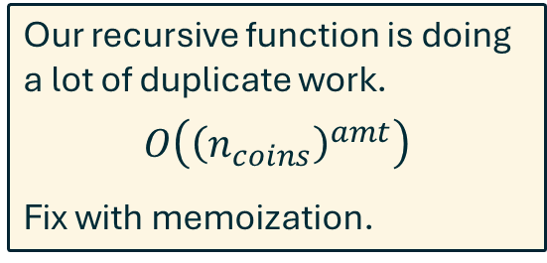
Our recursive function is doing a lot of duplicate work.
$$O\left({\left(n_{coins}\right)}^{amt}\right)$$
Fix with memoization.
amt = 7
coins = [1, 2, 3]
7
-1
-2
6
-3
5
-1
-2
-3
4
-1
-2
-3
5
4
3
4
3
2
-1
-2
-3
-1
-2
-3
-1
-2
-3
3
2
1
-1
-2
-3
4
3
2
3
2
1
3
2
1
-1
-2
-3
3
2
1

Slide 59
def fewest_coins(amt, coins):
# Base case
if amt in coins: return 1
# Recursive case:
# min_coins = min(1 + fewest_coins(amt-coin))
# Find valid next steps
possible_coins = [coin for coin in coins if coin <= amt]
# Explore each, looking for optimal solution
min_coins = float('inf')
for coin in possible_coins:
n_coin = fewest_coins(amt-coin, coins) + 1
# Did we find a new optimum?
if n_coin < min_coins:
min_coins = n_coin
return min_coins

Slide 60
def fewest_coins_memo(amt, coins):
solved = {coin:1 for coin in coins}
return _fewest_coins(amt, coins, solved)
def _fewest_coins(amt, coins, solved):
if amt in solved: return solved[amt]
possible_coins = [coin for coin in coins if coin <= amt]
min_coins = float('inf')
for coin in possible_coins:
n_coin = 1 + _fewest_coins(amt-coin, coins, solved)
if n_coin < min_coins:
min_coins = n_coin
solved[amt] = min_coins
return solved[amt]
Initial solved subproblems
Base case

Slide 61
How much does memoization help me?
==================================
------n_calls-------
amt n_coins w/o memo w/ memo
----------------------------------
25 1 25 25
25 2 150049 47
25 3 1468189 67
25 4 2360325 85
25 5 2071001 101

Slide 62
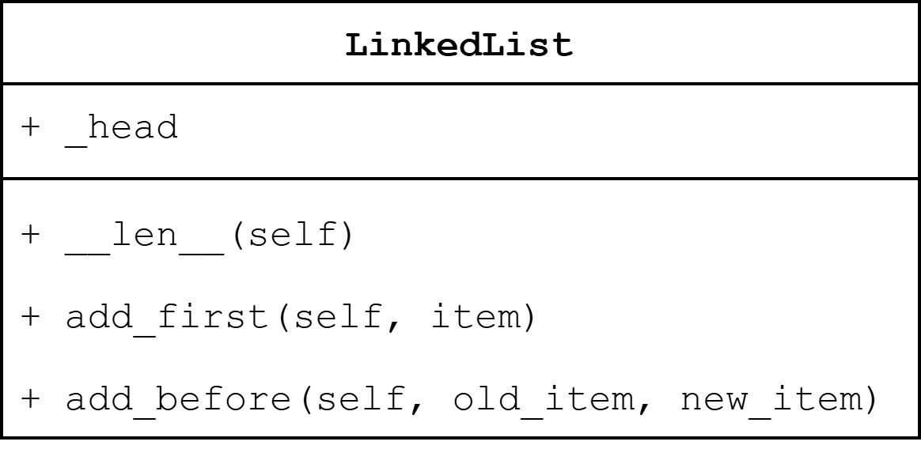
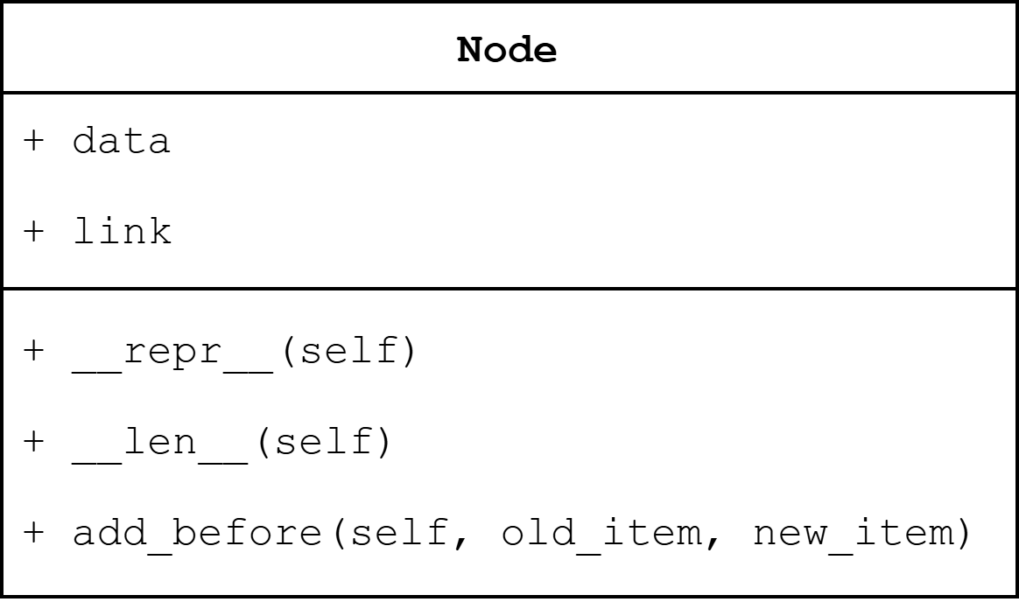
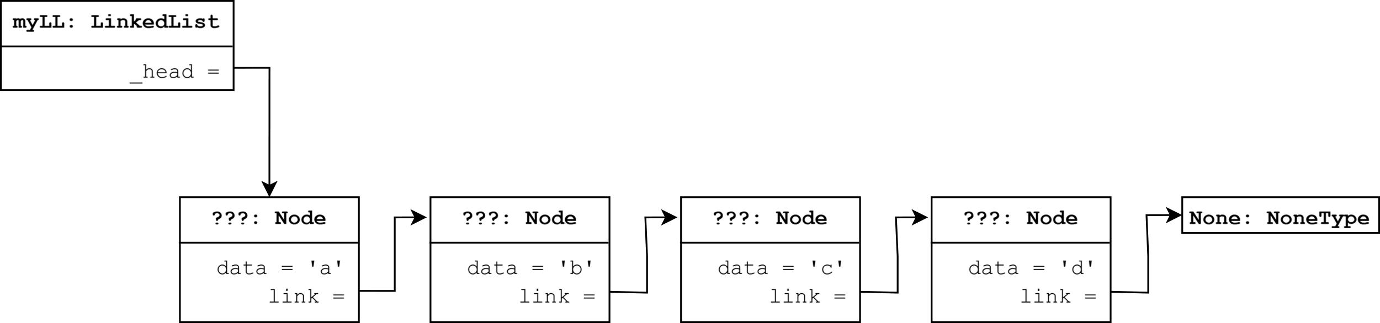
>>> myLL = LinkedList('abcd')
>>>

Slide 63
>>> myLL = LinkedList('abcd')
>>> myLL.add_before('c', 'r')

Slide 64
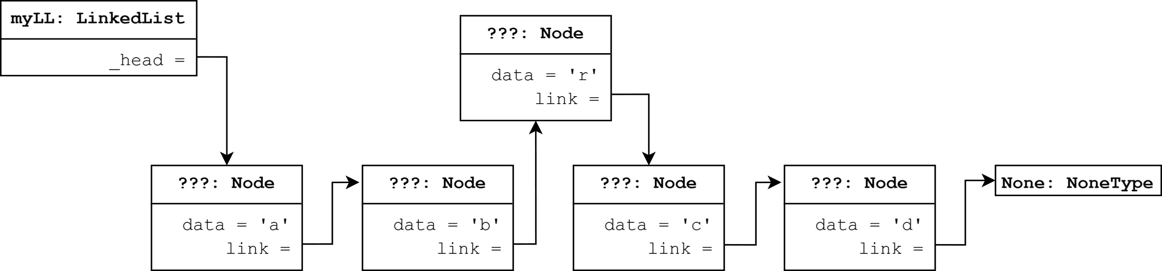
>>> myLL = LinkedList('abcd')
>>> myLL.add_before('c', 'r')

Slide 65
>>> myLL = LinkedList('abcd')
>>> myLL.add_before('c', 'r')
>>> myLL.count('r')
1

Slide 66
starter and solution code for recursive node in our shared directory: mod 05 code link

